Slide 1
Blockchain API ( Information Sharing Website as Demo )

Slide 2
Blockchain
Blockchain is a way of storing digital data.
The data can literally be anything.
For Bitcoin, it’s the transactions (logs of transfers of Bitcoin from one account to another), but it can even be files; it doesn’t matter.
The data is stored in the form of blocks, which are linked (or chained) together using cryptographic hashes — hence the name “blockchain.”

Slide 3
Constraints
All of the magic lies in the way this data is stored and added to the blockchain. A blockchain is essentially a linked list that contains ordered data, with a few constraints such as:
Blocks can’t be modified once added; in other words, it is append only.
There are specific rules for appending data to it.
Its architecture is distributed.

Slide 4
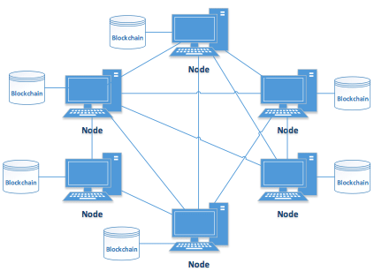
Distributed Architecture

Slide 5
Benefits Of Blockchain
Enforcing these constraints yields the following benefits:
Immutability and durability of data
No single point of control or failure
A verifiable audit trail of the order in which data was added
So, how can these constraints achieve these characteristics? We’ll get more into that as we implement this blockchain. Let’s get started.

Slide 6
About the application
Let’s briefly define the scope of our mini-application.
Our goal is to build an application that allows users to share information by posting. Since the content will be stored on the blockchain, it will be immutable and permanent. Users will interact with the application through a simple web interface.

Slide 7
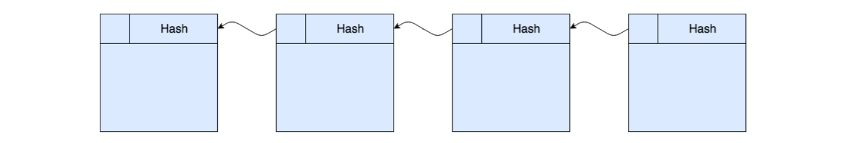
Hashing
A blockchain is a linked list of transactions which contains data and a hash pointer to the previous block in the blockchain.
In a blockchain, the hash of a previous block in a sequence is a tamper-proof.So if we change any variable of any one of the hashes in a given block would cause a domino effect, altering all of the previous transactions in the block.
We can't get data back from hashing, therefore security is enhanced

Slide 8
SHA-256 Hash in Java
In Cryptography, SHA is cryptographic hash function which takes input as 20 Bytes and rendered the hash value in hexadecimal number, 40 digits long approx.
Message Digest Class:
To calculate cryptographic hashing value in Java, MessageDigest Class is used, under the package java.security.
MessageDigest Class provides following cryptographic hash function to find hash value of a text, they are:
MD5
SHA-1
SHA-256

Slide 9
This Algorithms are initialized in static method called getInstance(). After selecting the algorithm it calculate the digest value and return the results in byte array.
BigInteger class is used, which converts the resultant byte array into its sign-magnitude representation. This representation is converted into hex format to get the MessageDigest
Input : hello world
Output : b94d27b9934d3e08a52e52d7da7dabfac484efe37a5380ee9088f7ace2efcde9
Input : GeeksForGeeks
Output : 112e476505aab51b05aeb2246c02a11df03e1187e886f7c55d4e9935c290ade

Slide 10
Thankyou !!

